Slide 1
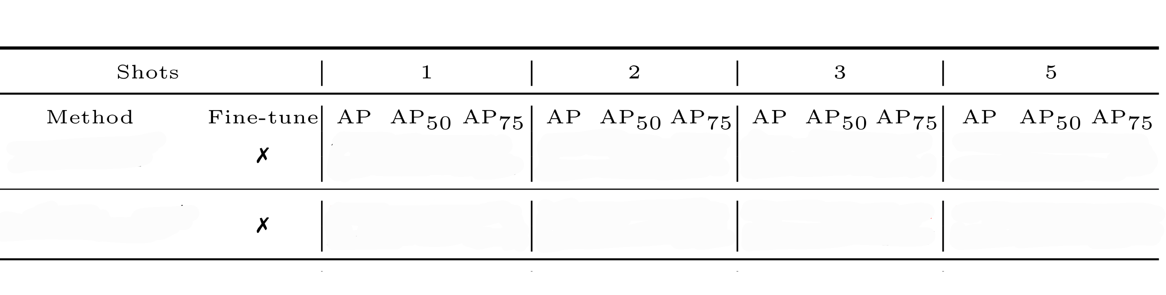
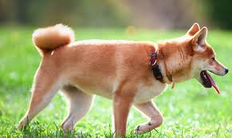

Sep 22 2022
Zihan
Extension of AirDet
Summary for the past week
Got familiar with Detectron2
Reproduced experiments w/o fine-tuning
in AirDet and FewX, got close results.
Visualization (in progress)
Fig 1. Part of reproduction results, COCO validation dataset
Original
5.97 10.52 5.98
6.58 12.02 6.33
7.00 12.95 6.71
7.76 14.28 7.31
RPN cls loss is large because…
Assumption 1: Existing appearance difference between S and Q.
Similar region may not be captured correctly and current multi-relation detector
could potentially introduce unnecessary or even harmful information to classification task.
Assumption 2: Task of distinguishing different category is much easier than that of classifying two objects into one category.
Reproduction
5.51 10.19 5.63
6.36 11.37 6.01
6.90 12.74 6.59
7.71 14.21 7.35
Support
Plan for the next week:
Look into false samples and proposal generation module, trying to found out why false examples can not work out.
Verify Assumption 1 and 2.
Loss prospective: Punish negative samples to prevent its dominating role in loss.
Query

Slide 2
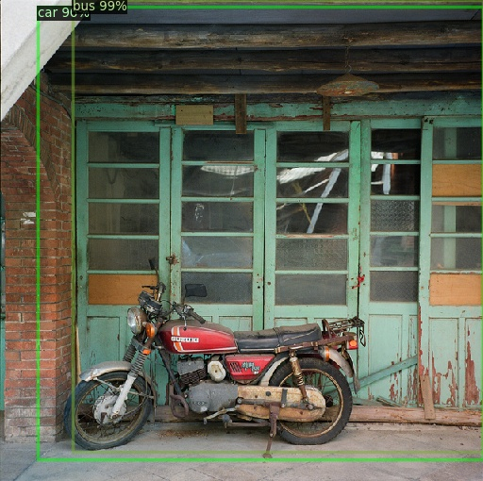
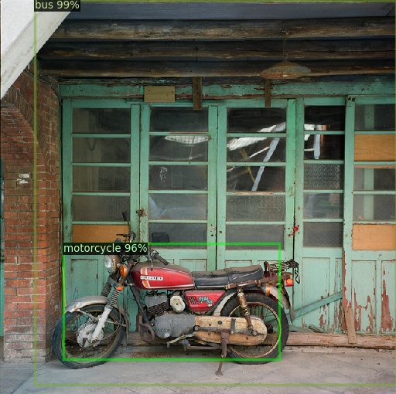
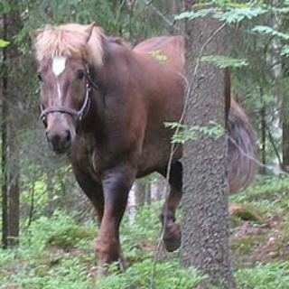
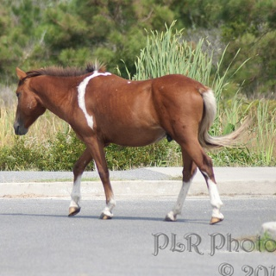
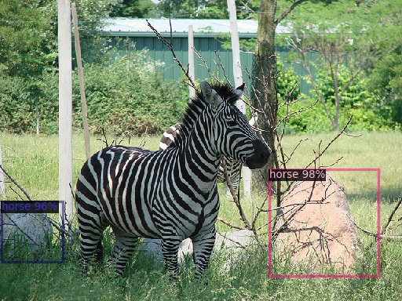
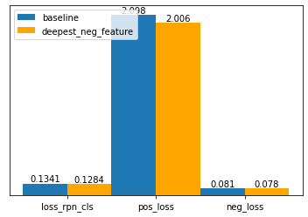
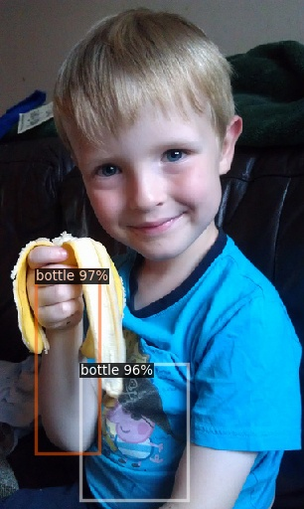
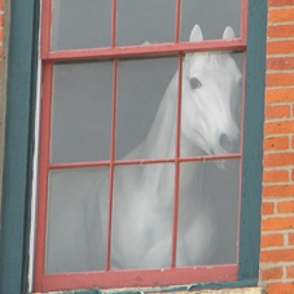
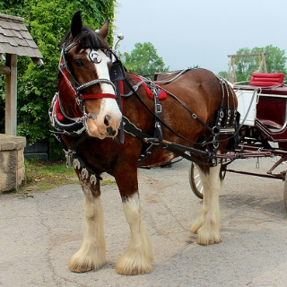

Sep 29 2022
Zihan
False Example
Summary for last week:
1. Simply punished negative loss ( Nearly no effect )
2. Tried only use deepest feature for negative branch
3. Visualization of False Samples:
Fail when appeance gap is huge. ( Interaction between
support images is possible? Maybe not realistic )
Model tends to capture simple sampels. ( Since focal loss
is proven not so good, currently no good idea about this)
Detection easily falls to shallow features, e.g. shape
(Distinguishment should use deepest feature: Not obvious)
3-Shot
5-Shot
Next step:
Fix the bug of camcan and search for better training strategy
Think about possible application of self-support (Fan Qi)
False Example
False Example

Slide 3
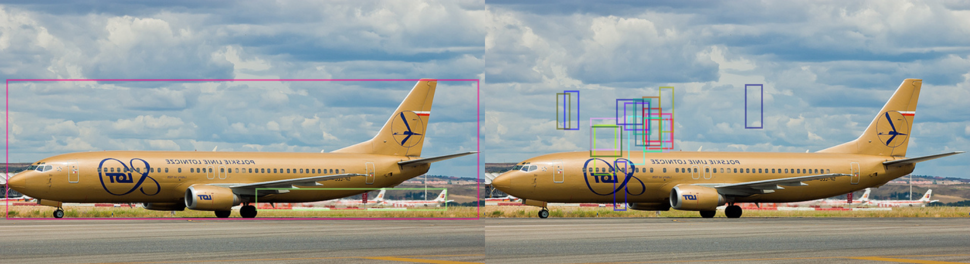
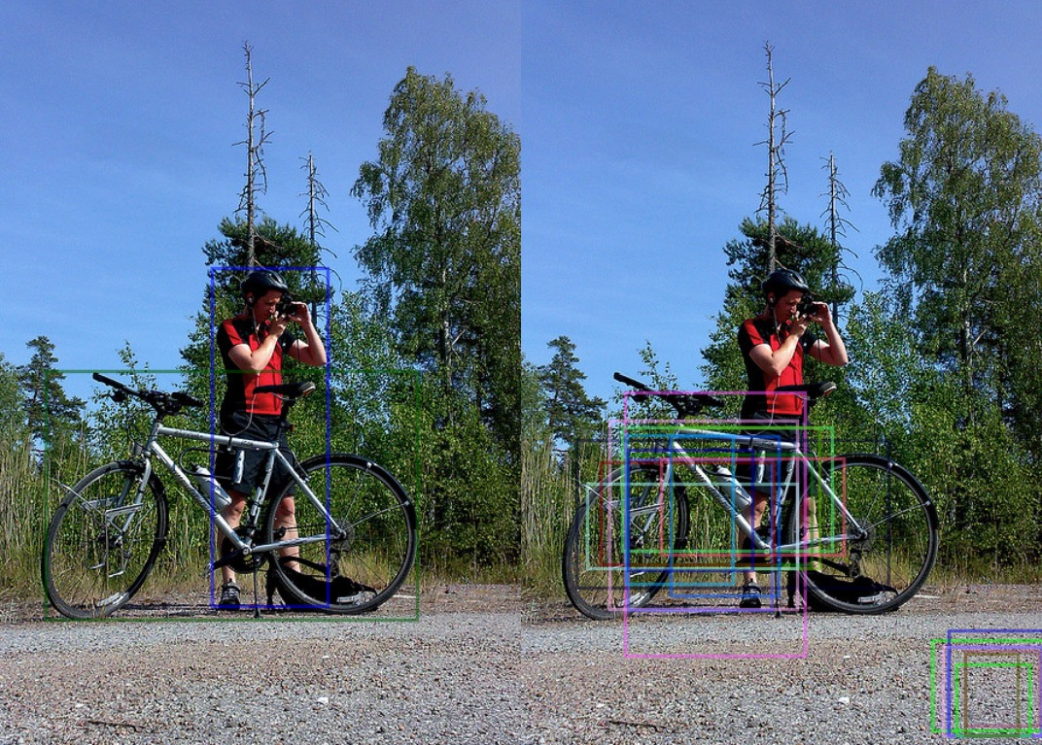
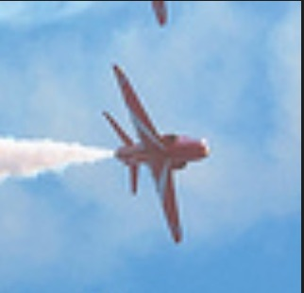
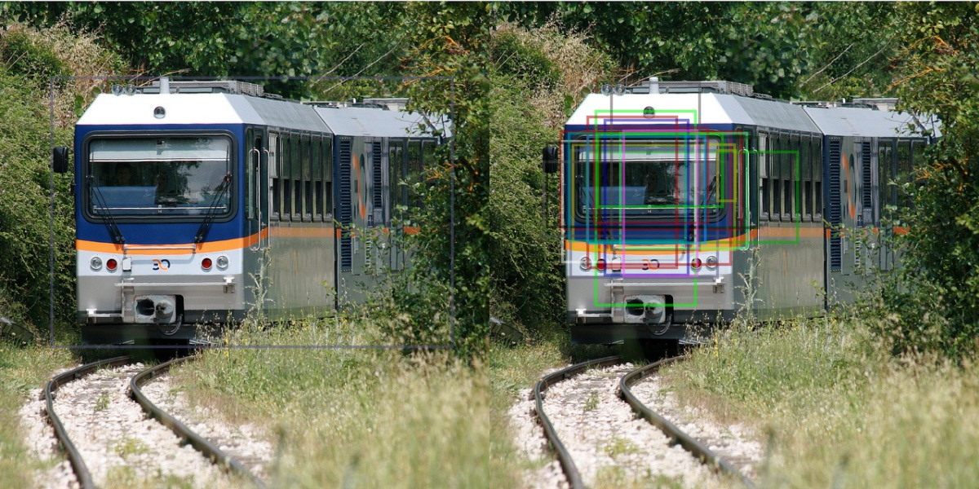
Oct 6 2022
Zihan
Visualization Part
Hight Positive Loss
Low Loss

Slide 4
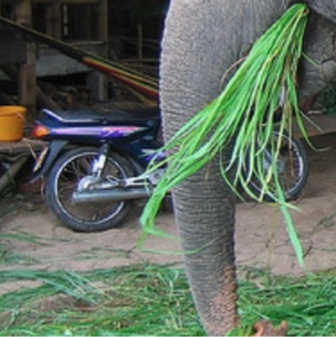
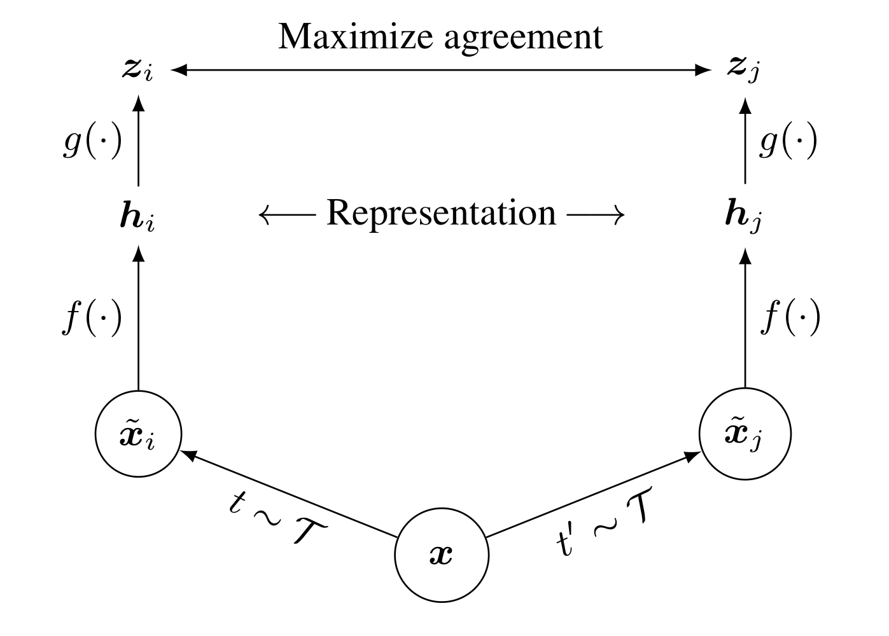
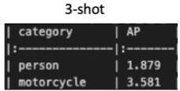
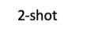
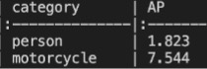
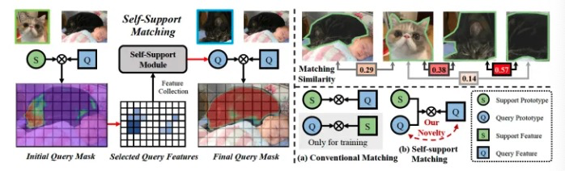
Next Move: 1. Try contrastive loss 2. Try support feature distillation 3. Try possible self-support matching application
1. Contrastive loss ( In progress )
2. Support Feature Distillation:
Interaction with support image
Interaction between support features is possible?
3. Try possible self-support matching application
Oct 6 2022
Zihan

Slide 5
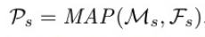
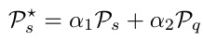
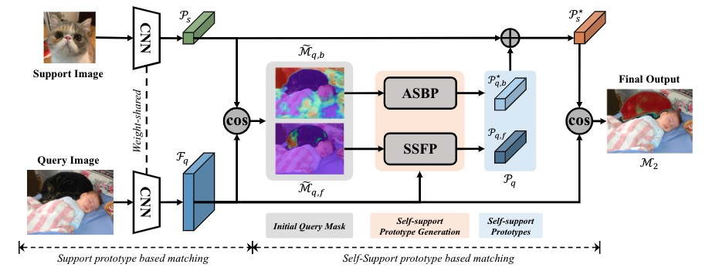
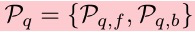
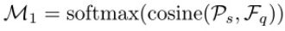
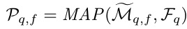
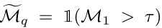
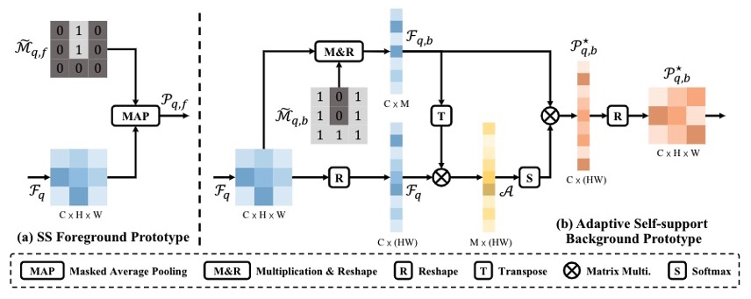
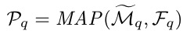
Oct 20 2022
Zihan
Regular:

Slide 6
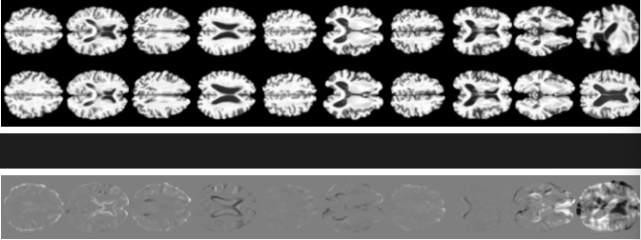

Slide 7
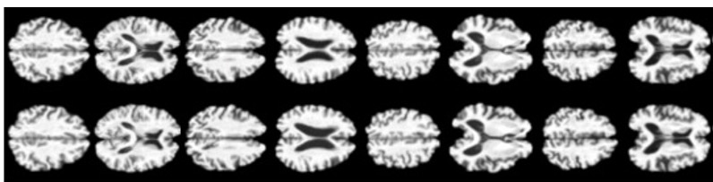
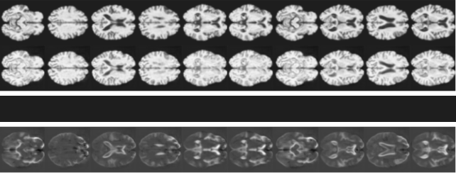

Slide 9
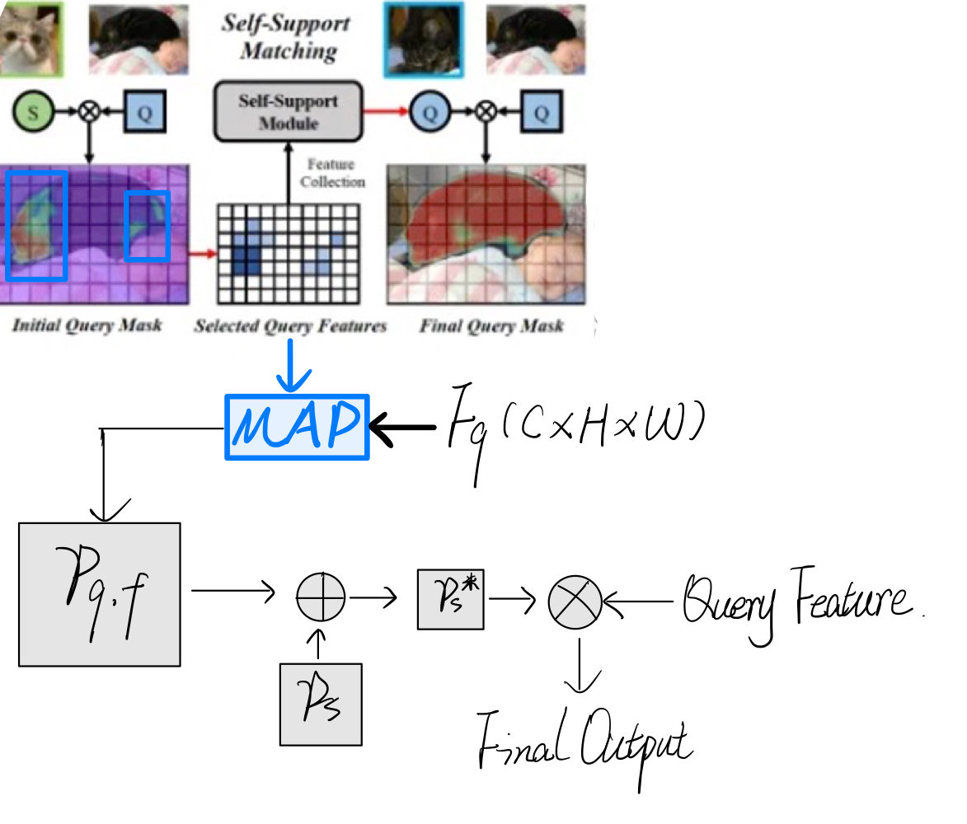
Oct 20 2022
Zihan

Slide 10

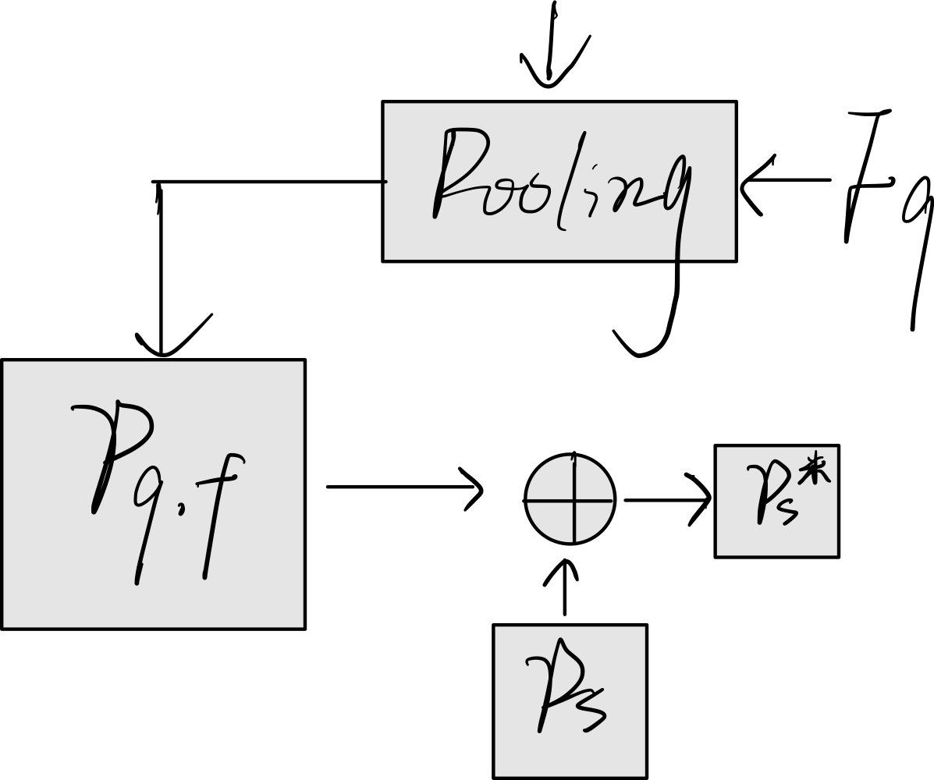
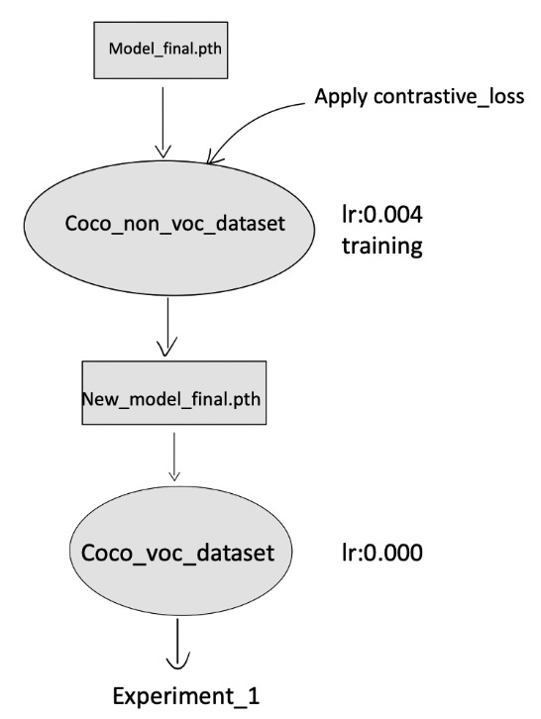
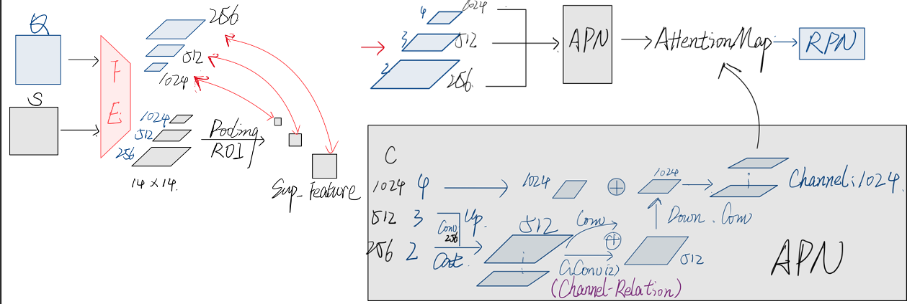
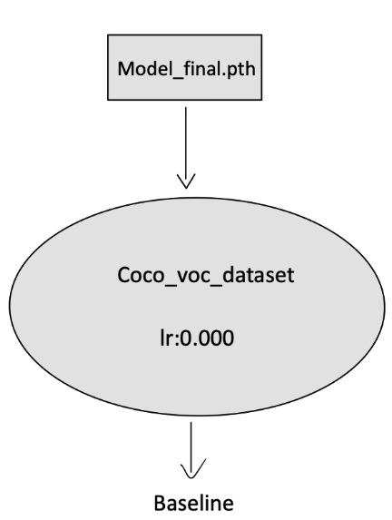
Oct 27 2022
Zihan
AirDet:
Recap:
1. Generating bboxes in positive area.
2. classifying bboxes containing positive instances(e.g. cat ) as cat.
If training from scratch, annotations are needed as supervision.
Here pre-trained model from AirDet is used to
validate effectiveness .
attention map
Training Process
load
load
Another 10000 iters
load

Slide 11
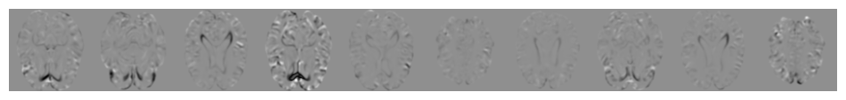

Slide 12
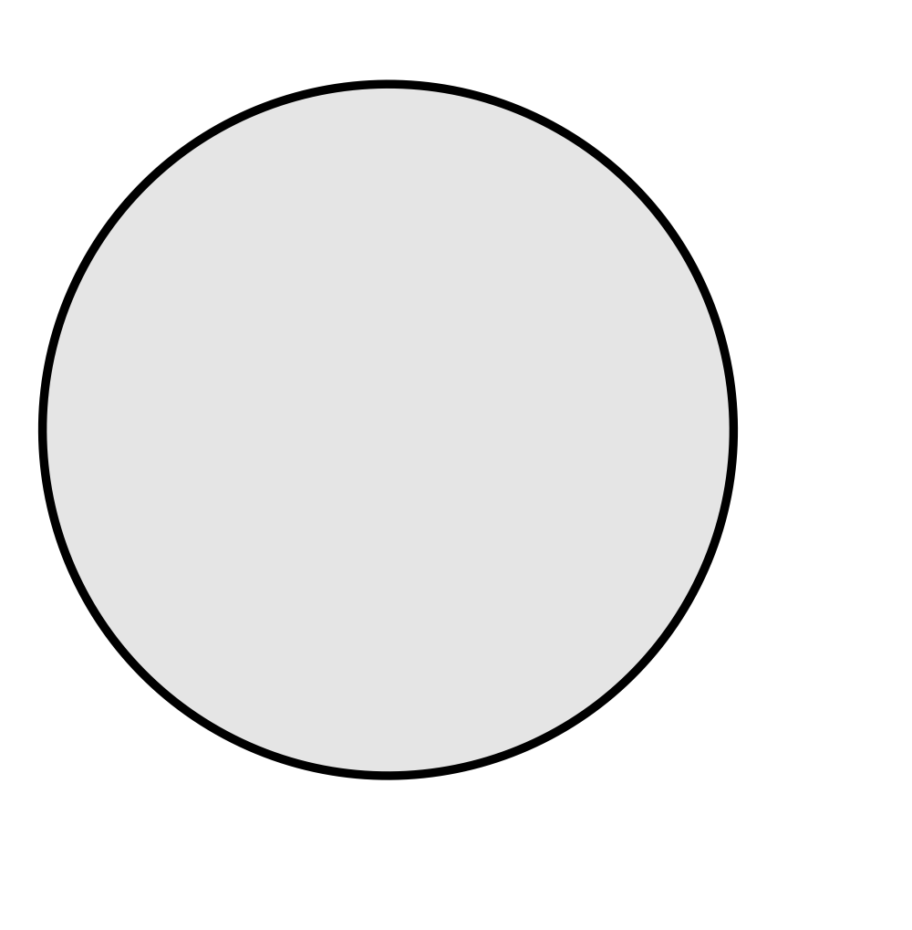
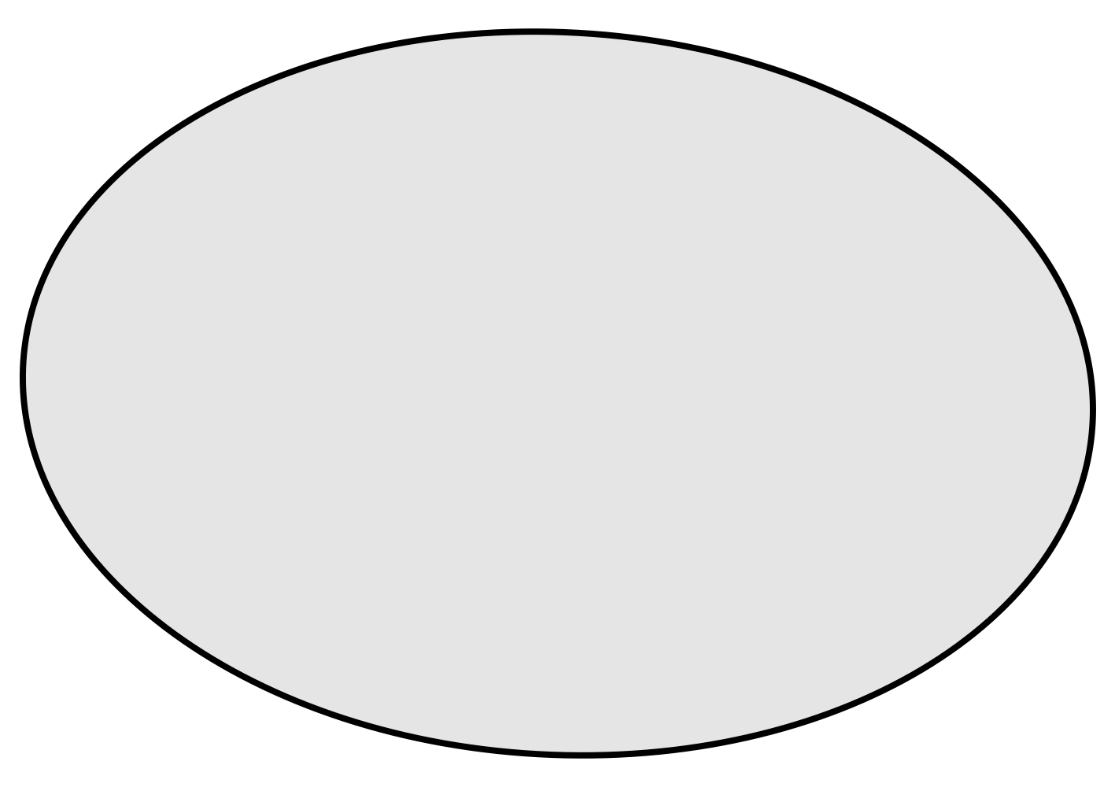

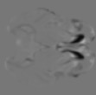
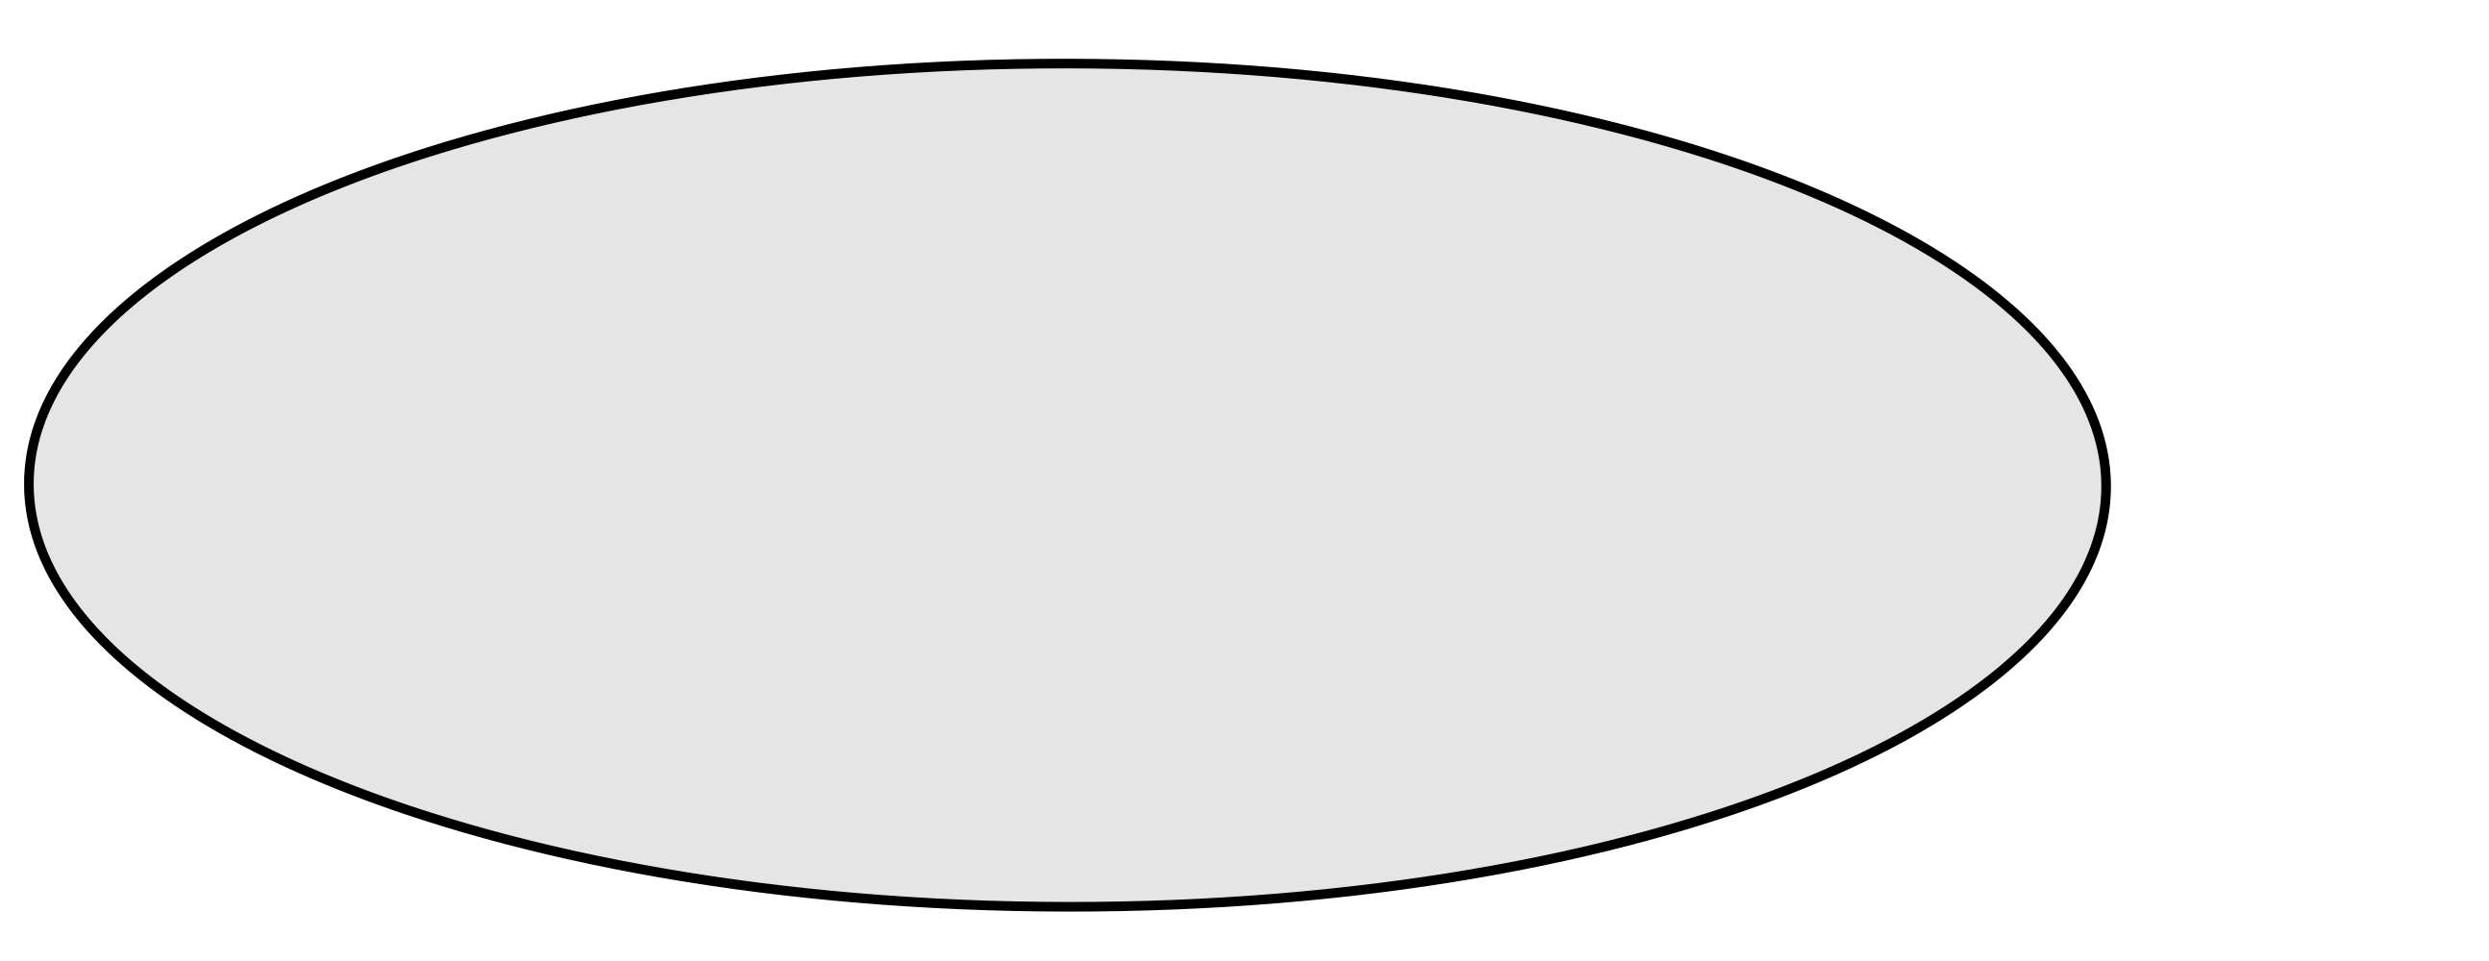
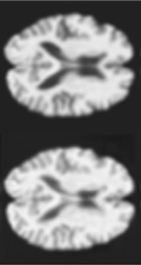
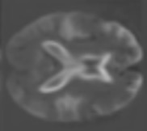
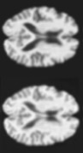
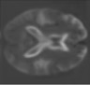
Age
Image
Implicit Factors

Slide 13
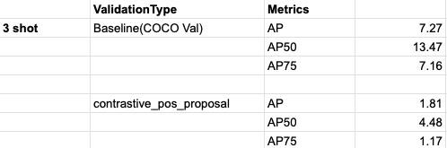
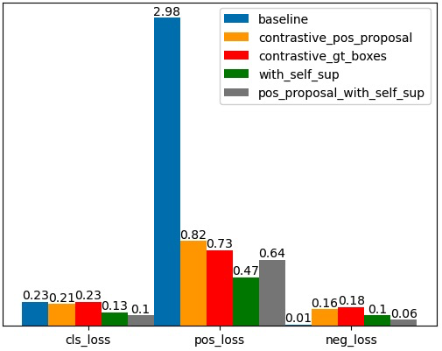
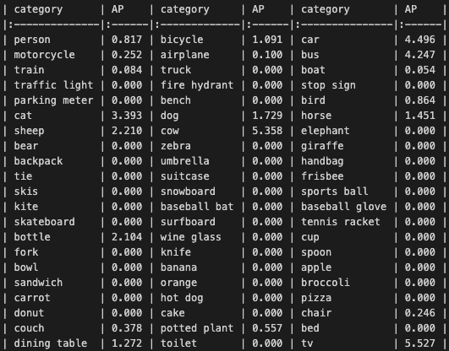
Oct 27 2022
Zihan
Inference:
Planning for next week:
Finish reading two papers
Debugging:
Check overfit issue
Check testset for loss calculation
Check different support setting
Loss on VOC_20_classes of coco datasets, lr =0

Slide 14























Short-Term
$${input:x}_{i}$$
$${output:x}_{o}$$
error$:x_{o}−x_{i}$
$${input:x}_{i}$$
$${output:x}_{o}$$
error$:x_{o}−x_{i}$

Slide 15






Dataset for loss calculation:
loss calculation during training: coco_2017_val_voc
test dataset during inference: coco_2017_val_voc
Are there only 20 Voc Classes? -- Yes
Support During Training
Loss Calculation
Inference

Slide 16


Oct 20 2022
Zihan
Minimize
Cosine_Similarity
(128, 2048, 7, 7)
Positive Proposal Correlation Features
(gt_num, 2048, 7, 7)
Negative Correlation Features
(gt_num, 2048, 7, 7)
SCS
(Arrow means generation)
Positive Correlation Map
( 1, 1024, h, w )
Negative Correlation Map
( 1, 1024, h, w )
Gt_boxes
Gt_boxes

Slide 17


Nov 17 2022
Zihan
Summary:
Validated the feasibility of applying contrastive loss between positive features and negative features extracted in the ground truth box region.
Fig 1. Loss distribution of RPN measured in VOC_20 dataset
Fig 2. Inference Results

Slide 18
Reference Draft --- illustration
Period: Mid Sep. – Now
Reproduction
Independent Research
Pypose Development(in progress)
Reproduction:
Research
AirDet
Attention-RPN
Self-Support Segmentation
Classification problem(Main)
Long inference time(Following)
Heavy model(Not Considered Now)

Slide 19
Classification problem
Definition:
Poor performance of classification of positive class, specifically in RPN and detection head.
Different Training Strategy 1. Introduce contrastive loss 2. Introduce focal loss
Motivation : the model cannot recognize positive samples -> Let the model learn to
distinguish between positive and negative samples (The features used for contrastive
computation are extracted from the correlation map by gt_box)
It does help to improve performance for the classification of positive class but the inference result gets worse because of increasing false positives.
Motivation: Large inter-class variance, the existence of hard samples.
Focal loss indeed makes the model focus more on hard samples, however, it makes the easy sample harder to learn, which makes the inference results worse.

Slide 20
Constrained Optimization: in progress
Reduce Intra-Class Variation
Introduce neighbor information:
measure the similarity of adjacent patches to reveal the structure and layout of the image.
( In the process of implementing )
Utilize the information provided by query images as self-support: Tried on adjusting inference codes only: limited enhancement for only a few categories Backup Plan: Create masks as supervision and training from scratch.
Long inference time:
Cause: The SCS module and detection head of AirDet will run loops in all the support classes and find the highest score among all classes.
Initial Idea: Add pre-processing strategy to reduce the number of needed loops.

Slide 21



measuring similarities of a local patch within its neighborhoodc
Hadamard product
SCR
Notes:
SCR is to focus on relevant regions in an image.
CCA analyses feature correlations between different images
度量附近patch的相似性来揭示图像的结构布局
Channel-wise correlation

Slide 22


Slide 24
Oct 20 2022
Zihan
Minimize
Cosine_Similarity
(gt_num, 2048, 7, 7)
Positive Proposal Correlation Features
(gt_num, 2048, 7, 7)
Negative Correlation Features
(gt_num, 2048, 7, 7)
SCS
(Arrow means generation)
Positive Correlation Map
( 1, 1024, h, w )
Negative Correlation Map
( 1, 1024, h, w )
Gt_boxes
Gt_boxes

Slide 25




Slide 26


Slide 27



Performance Part
Dec 8 2022
Zihan

Slide 28


Neibor info Extraction

Slide 29


Results
Possible Reason:
1. Single Level
2. Inappropriate window size
3. Relatively independent 2 branches
With res_4 only:
Loss on training set:
Inference results:

Slide 30

Next Step
Complete multi-level neighbour information design, fine-tuning the size of the local window.
Find reliable metrics to filter the class before the proposal generation.

Slide 31


Slide 32




Slide 33


Inference time or the total time to run the code?
i.e. we

Slide 34


+ Detection Head, Exact object correlation features
Directly extract information from the correlation map?
What we have…
1. 3-level correlation maps for each novel class
2. Class prototype for each novel class
Multi-level Correlation -> SCS -> Correlation Map -> Proposal Generation -> Detection Head

Slide 35
Inference Part
If the test set has 20 categories, it generates proposals for 20
classes, and then calculate the score in a loop. If a query image
contains 5 classes, then there are maybe 10 unnecessary calculations.

Slide 36


Bug Fixed

Slide 37
Idea: Use rough classification to reduce the needed classes in the loop.
Objective:
A general plug-and-play network(time-efficient) to filter the classes.
General cases:
Correlation maps and support class prototype.
Deeper look…
1. Backbone should be neglected as the strategy should work for all the backbone.
2. Shots aggregation is stored, it is fixed as well. (Can we utilize pre-knowledge from support prototype?)
3. SCS is designed for small object detection and must used in all class. Possible substitution efficient for small object?

Slide 38
Closer Look
Traditional: for class in novel_cls: 1. Features Fusion ( 20 x SCS ) 2. Generate proposals based on correlation maps fused after SCS and store ( 20 x proposal_cost) In detection head: Extracted features are finely classified and ranked by score. Total Cost: 20 x SCS_cost + 20 x proposal_cost + 20 x fine_cls_cost
Possible Improvement: 1. General cases: Some cls did not appear, can we filter the non-existing class? Specifically, can we learn a mapping from correlation maps to how likely there exists such an object? Total Cost: 20 x SCS_cost + M x proposal_cost + M x fine_cls_cost ( take M = 5 for comparison ) 2. For AirDet: SCS is time-consuming, what if we skip it or replaced it? Total Cost: M x proposal_cost + M x fine_cls_cost ( take M = 5 for comparison )

Slide 39




Experiment Steps Details:
Check availability---Check, the strategy did reduce inference time regardless of the precision degradation.
Set the trivial method for baseline---Check, It sets a ceiling for the optimal inference time and we introduce omission rate as metrics.
Q
20 x correlation_maps
For Each
Norm
ReLU
Num_Nov(20) -> Fine_Cls(5)
20 x S
AVG
20 x score -> sorted[:Fine_Cls] -> Detection_Head
omission_rate = 1- precesion_novel / precision_tradition

Slide 40

Problems:
Problems:
Q
20 x correlation_maps
For Each
Norm
ReLU
Num_Nov(20) -> Fine_Cls(5)
20 x S
AVG
20 x score -> sorted[:Fine_Cls] -> Detection_Head
with
Not flexible: Sent fixed num of cls to detection head. -> Set a threshold.
This avg strategy cannot make an observable difference.
Improvement regarding inference time accepted? If yes, -> Core is to reduce omission rate new ‘score’ .
The difference between appeared sup_cls and not appeared should be large enough.
Detect the most possible novel classes from correlation maps.
Next Step : Design a network to reduce omission rate --- Ongoing, thinking about introducing correlation among all the novel classes. (Extra cost, availability is to be verified, got 105 correlation in VOC20 or (N+1) * N / 2 in general.)

Slide 41


Revisit SCS
1: Fuse 2,3 (256->512)
2: Channel Relation (512->512)
3: Down_sample (512->1024)

Slide 42




20
5
1
3

Slide 43




Relation Extractor
256
128
Conv(Cat(A, B)) + Cat(Conv(A,B))
1
1x1
Cat
AVG
Sigmoid
Score
MaxPool
x2
MaxPool
[1,2]
Correlation Map
(1,256, w/4, h/4)
(1, 1024, w/4, h/4)
(1, 128, w/4, h/4)
(1, h/4, w/4,256)
Inference Time: 1/3 * SCS
Transferability(Loss perspective): 0.01(base, seen) -> 0.2(novel, unseen)
Performance with full-inference(20 classes) compared with AirDet:
5% Enhancement -> Discrimination of Correlation Map -> Grants margin for AP drop.
Results:
Did bring the linear separatable score
Did reduce inference time about 30 percent on 4 A-100.
Neither top K nor dynamic choose performs better than trivial method (score not reliable)
Discussion: The design of MLP: Transferability consideration, but we cannot fine-tune.

Slide 44

Constrained_Optimization
Zihan WANG
c
What I have done:
General penalty function optimization with equality and inequality constraints.
KKT condition verification.
Augmented Lagrangian Algorithm( almost complete )
Next Step:
Test and polish the code.
The complete code pull will be done by the end of this week.
Expand the Penalty Method. (Currently got quadratic, thinking about exact penalty methods.)

Slide 45
Problems and what is next…
During inference, we are doing subtraction not optimization. Subtraction: 1. SCS: aimed at small objects. 2. Detection Loop: prevent omission.
What we ignored: correlation between highly similar classes.

Slide 46



ALM
Given a problem:
The gradient is given as:
We want to find the NN weights p to minimize the error
Given the constrains C(p):

Slide 47




two-level nested loop structure
Parameters,
Objective,
Constraints,
Lagrange Multiplier,
inner problem: solved with conventional unconstrained algo. (LM)
outer loop: update L.multiplier and p.f. based on constraint violation.

Slide 48
Required Actions
Lagrange Multipliers(Check)
Define First-order optimality conditions(Check)
Define KKT condition(Check)
Finish Penalty Method(Check)
Finish augmented Lagrangian(wtf the constrains…nn.modoel, return violation)

Slide 49

Important Change

Slide 50
Idea: Use rough classification to reduce the needed classes in the loop.
Objective:
A general plug-and-play network(time-efficient) to filter the classes.
General cases:
Correlation maps and support class prototype.
Deeper look…
1. Backbone should be neglected as the strategy should work for all the backbone.
2. Shots aggregation is stored, it is fixed as well. (Can we utilize pre-knowledge from support prototype?)
3. SCS is designed for small object detection and must used in all class. Possible substitution efficient for small object?

Slide 51
Experiment Steps Details:
Check availability---Check, the strategy did reduce inference time regardless of the precision degradation.
Set the trivial method for baseline---Check, It sets a ceiling for the optimal inference time and we introduce omission rate as metrics.
Q
20 x correlation_maps
For Each
Norm
ReLU
Num_Nov(20) -> Fine_Cls(5)
20 x S
AVG
20 x score -> sorted[:Fine_Cls] -> Detection_Head
omission_rate = 1- precesion_novel / precision_tradition

Slide 52
Quick Summary
Progress:
Finished evaluation algorithm and visualization.
Achieved a better model than AirDet, with an increment of 15%.
Problems:
If jointly training, the loss is hard to decrease.
The model failed to predict better than the trivial method.

Slide 53

Distribution of the num of cls in testset…
Normally the novel_cls_num will not exceed 3, which explains the availability of our method.
Total: 5000

Slide 54
Last catch-up
Objective
Class-agnostically infer existence/absence directly from correlation maps for each support class.
Class-Agnostic Correlation Map
Linear Separatable Logits/Score
Progress:
Decrease omission rate
Increase efficiency
Separately training -> LOSS DID DECREASE
Correlation Map Level -> LEVEL 4 BETTER THAN FUSED FEATURE
Missing local information -> NEW METHOD FOCUSE ON LOCAL PATCH

Slide 55


20
NUM

Slide 56


20
NUM

Slide 57


Training Progress
1. Jointly training from scratch:

Slide 58
Last time Catch-Up
Fixed iter -> 60k
Revised to softmax()
Correlation Map Level -> Level 4 is better
Tried new model -> still worse than simple relu+avg. (CAM_like)
Attention:
All the results are obtained by training the discriminator only(freeze other components). The iters are the same as 60K.

Slide 59


2. Frozen other nets, only train the discriminator:
Score obtained by the network:
(AirDet)
(Final goal)
Score obtained by trivial GAP:

Slide 60



Correlation Map Level -> LEVEL 4 BETTER THAN FUSED FEATURE
We do see the probability of skipping SCS in the first loop, which takes
majority of inference time in current design.
fused
4
3
2

Slide 61


Missing local information -> NEW METHOD FOCUSE ON LOCAL PATCH

Slide 62


If use trivial method, the best sample result is desirable, however it depends on the base model not the designed net.

Slide 63

Attention_1
Increment in precision but decrease in recall.

Slide 64



Slide 65


Current Progress
Better Model(Enhancement for all shots, Max 20% )
Fast Efficiency(Allows to skip any feature fusion[perhaps more experiments?]), thus achieving generalization, up to 60%)
Pending the last step…NET…

Slide 66
Important Comparison
Intra-model
1. Enhanced Baseline.
2. Non-necessary feature fusion.
3. Proposed pre-selection module.
Inter-model
Real-World Test, given 3 models, A-RPN, AirDet, and AirEff(ad hoc).

Slide 67

Babystep training weights

Slide 68

Paper Construction
Baseline Enhancement: verify generalization, AirDet, (and A-RPN). Evaluate in-domain and cross-domain performance.
Skip Feature Fusion w/o performance damage( extra experiment ) 1. (Record other feature fusion methods, the proposition of time-consuming.)
2. Compare performance with skipping and w/o skipping
Binary Pre-selector with different strategy(10, 5, th): 1. Trivial method w/o supervision 2. NetWork 3. (Ablation study for network design)
(Visualization): 1. Grad-cam of binary classifier. 2. Grad-cam of correlation map fed into RPN.
(Real-World Test), Inter-model comparison

Slide 69
Progress updates
Intra-model
1. Enhanced Baseline in-domain + cross-domain.
2. Proposed pre-selection module.
3. Discuss the performance of pre-selection in terms of t, OR.
Inter-model
Real-World Test, model competition: A-RPN, AirDet, and AirEff(ad hoc).
Paper construction
Finished 3 out of 8. I might need the explorer pictures..

Slide 70

Enhanced Baseline
Define AirEff = Jointly-trained AirDet + Binary Classifier on fused correlation map,
We show all test setting for both in-domain(COCO) and cross-domain(VOC) evaluation

Slide 71
Missing local information -> NEW METHOD FOCUSE ON LOCAL PATCH
Old Net
Trivial(TVL) Method w/o Supervision

Slide 72


Old Net. vs Tvl.
Possible Ensemble?

Slide 73

Current Net Design
Detection
Head
RPN
SCS
Results
Filtered correlation map
1024
3x3 MaxPool
Avg(dim=[2,3])
C
Score
1024
Norm(dim=3)
Avg(dim=[2,3])
2048
128
2
ReLU
(1, 1024, h, w)
All sets of correlation map(20)

Slide 74


Evaluation
Time, of course.
AP or Recall?
AP: minimize the performance drop.
Recall: verify the performance of sole module.
Note that the upper level is not 100%! Define correct cls prediction as $C_{T}$, ${\text{the} \text{false} \text{prediction} \text{as} C}_{F}$
Recall C class, C = $C_{T}+C_{F}.$
we want $C_{T1}>C_{T2}$ instead of $C_{1}$ ${>C}_{2}$
i.e. Low-quality correlation maps would also lead to false predictions and thus will not affect the precision.

Slide 75




Omission Rate(OR. Ad hoc)
COCO, in-domain, Net_drop_mean: -1.07%, Tvl_drop_mean: -4.07%
VOC, cross-domain, Net_drop_mean: -3.44%, Tvl_drop_mean: -9.21%

Slide 76



Cls-Wise Recall
Tvl
Trivial
Net
Compare

Slide 77

Inter-model comparison
Define AirEff = Jointly-trained AirDet + Skip SCS + new inference strategy.
Take 3 shots to present.
The gap between _10 and _5 demonstrates that our method cannot detect precisely. Given a query image contains class_0 an class_1, they might rank in 6th or 7th .

Slide 78
Paper Construction
Baseline Enhancement: verify generalization, AirDet, (and A-RPN). Evaluate in-domain and cross-domain performance.
Skip Feature Fusion w/o performance damage( extra experiment ) 1. (Record other feature fusion methods, the proposition of time-consuming.)
2. Compare performance with skipping and w/o skipping
Binary Pre-selector with different strategy(10, 5, th): 1. Trivial method w/o supervision 2. NetWork 3. (Ablation study for network design)
(Visualization): 1. Grad-cam of binary classifier. 2. Grad-cam of correlation map fed into RPN.
(Real-World Test), Inter-model comparison

Slide 79

Next Step
Try jointly training with the current design and compare the effect.
Deep visualize heat map before RPN and compare.
Is it necessary to reduce inference further? DP:
Once the model is determined, do
Exhaustive Test
Visualization
Warp to real-world test

Slide 80
Last catch-up with Chen
For evaluation, choose method best shows our advantages.
Generally, he thinks current progress is great

Slide 81
Last Catch-up
Real-world ROS

Slide 82
Pre-Selector

Slide 83

Feature Fusion
Shots Aggregation
Pre-Selector
Detection Head

Slide 84

Recall
Top 10
Full iteration

